Slide 1
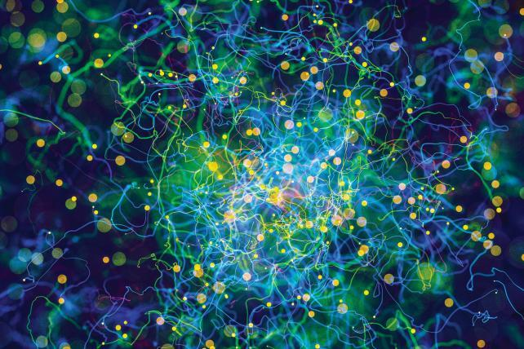
Deep Learning
Día 1
EXPOSITOR: Ing. Giorgio Morales Luna
Junio 2018

Slide 2
1. INTRODUCCIÓN

Slide 3


1.1. APLICACIONES DIARIAS DE DEEP LEARNING
Buscadores

Slide 4


1.1. APLICACIONES DIARIAS DE DEEP LEARNING
Facebook
Netflix

Slide 5

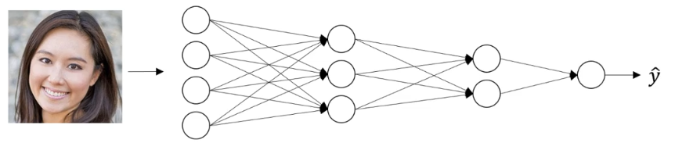
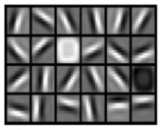
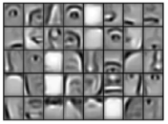
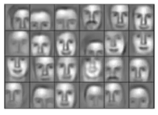
1.2. ¿Por qué Deep Learning?
Low-level audio features:
+? / -?
Ruido?
Tono
Fonemas
“C”, “A”
Palabras
Frases/Oraciones

Slide 6
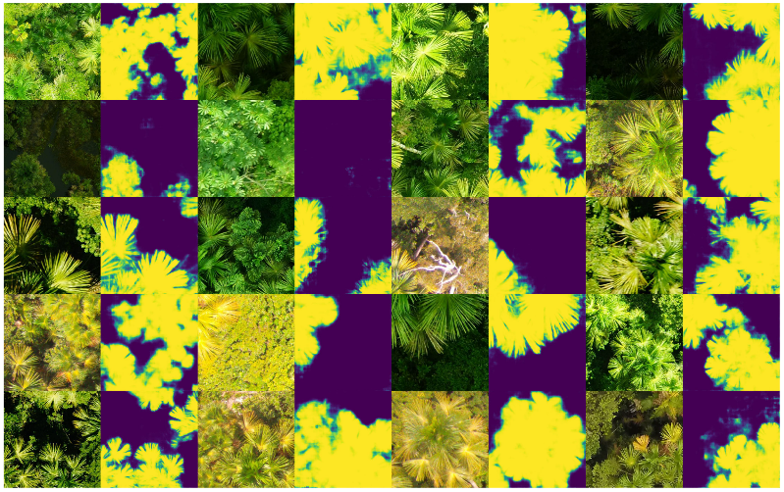

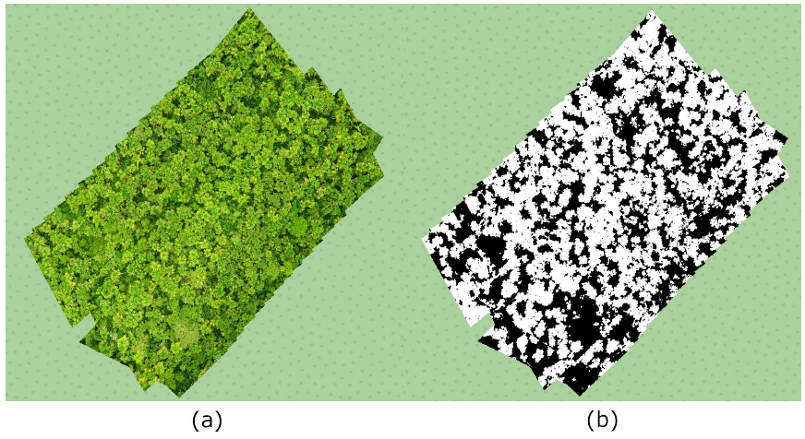
1.3. Trabajos Pasados
Software de Segmentación de Aguajes en Imágenes Aéreas

Slide 7
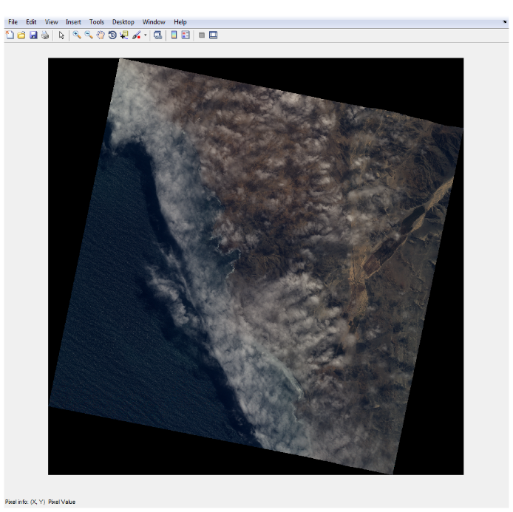
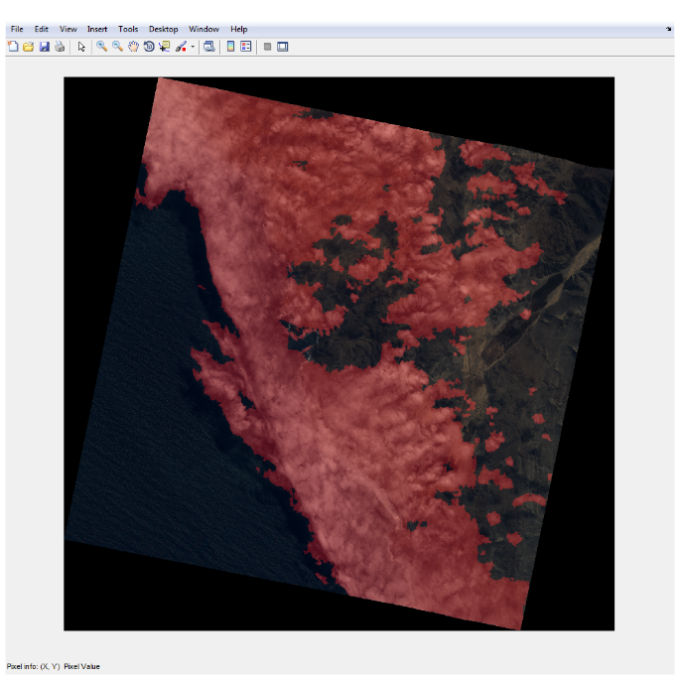
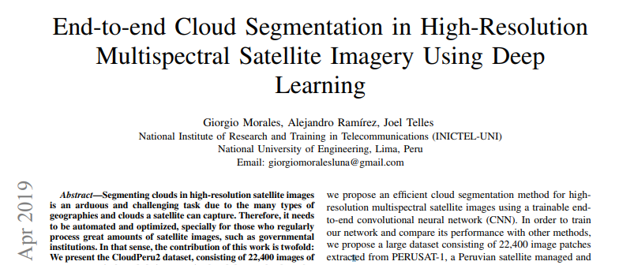
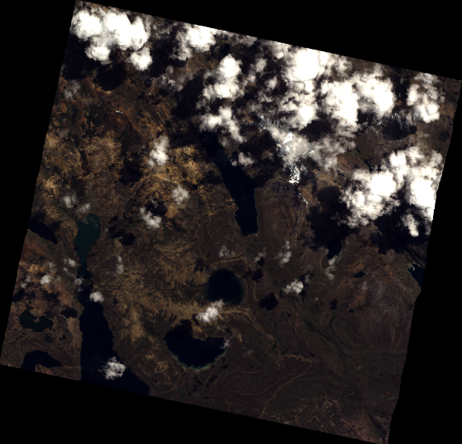
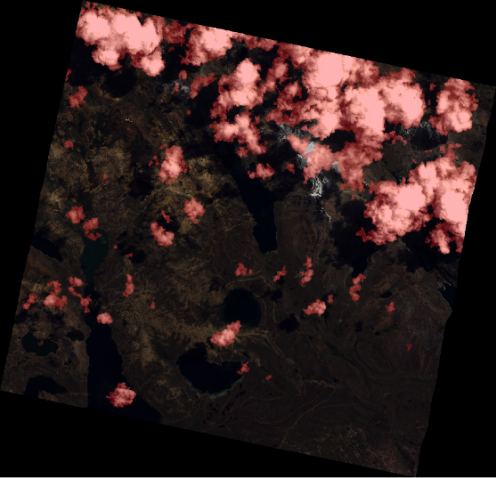
1.3. Trabajos Pasados
Software de Segmentación de Nubes en Imágenes
PERUSAT-1

Slide 8
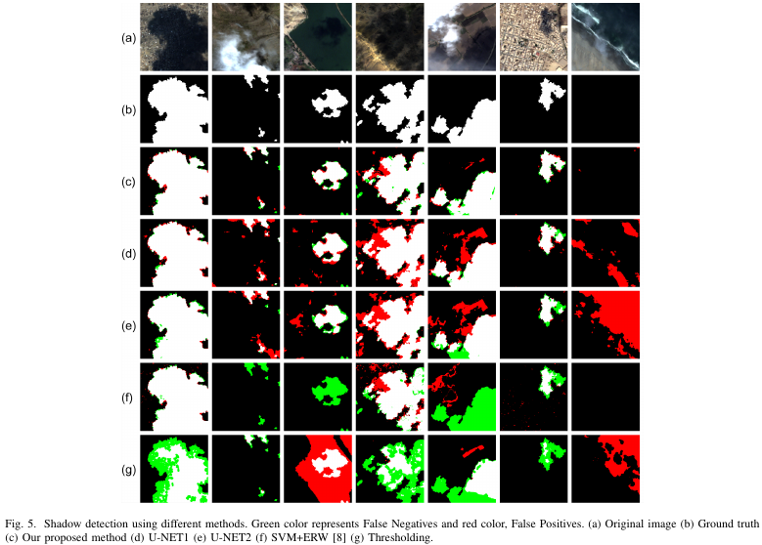
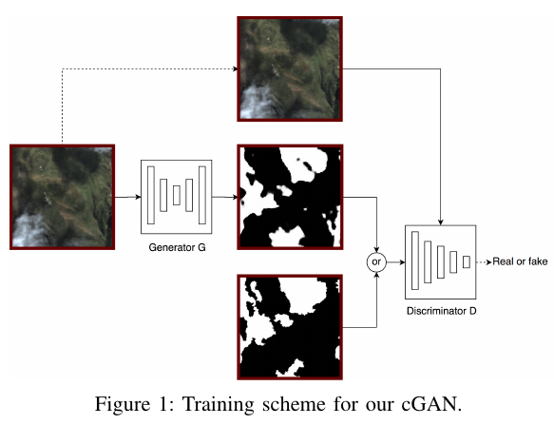
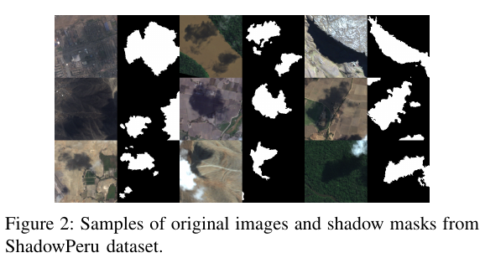
1.3. Trabajos Pasados
Software de Segmentación de Sombras en Imágenes
PERUSAT-1

Slide 9
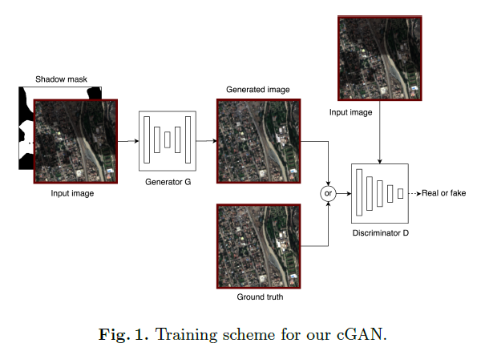
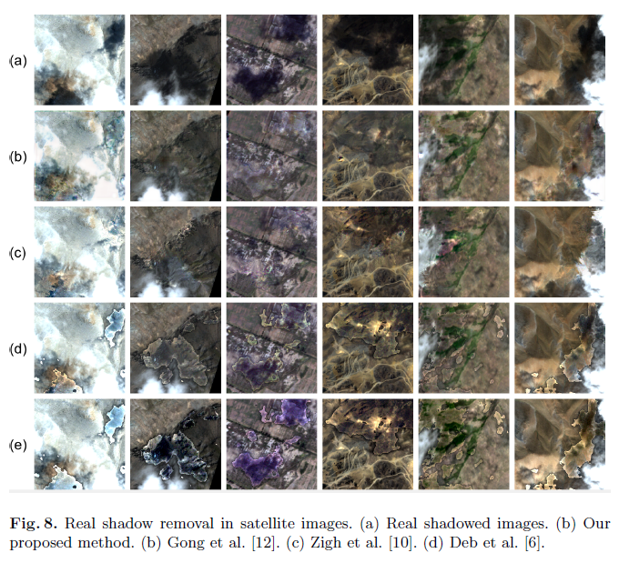
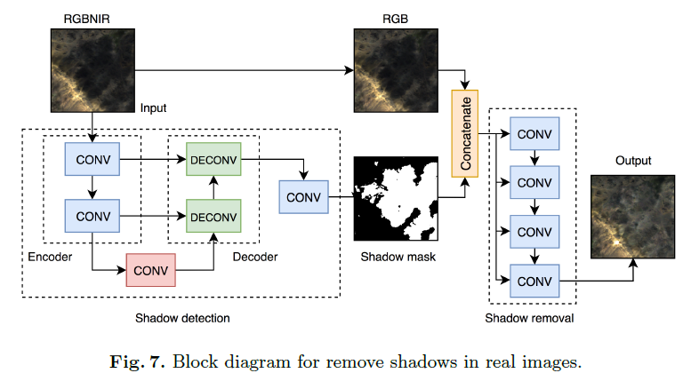
1.3. Trabajos Pasados
Eliminación de Sombras en Imágenes PERUSAT-1

Slide 10
2. INSTALACIONES

Slide 11
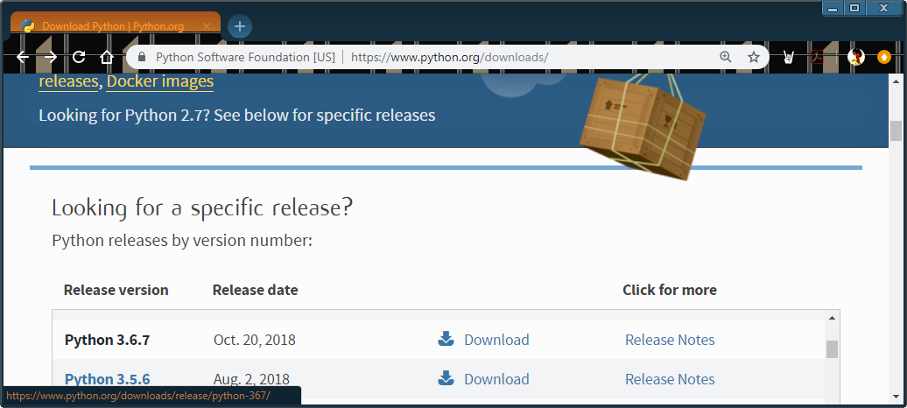
2.1. Python
Descargamos Python 3.6.7. de https://www.python.org/downloads/ (Windows x86-64 executable installer).

Slide 12
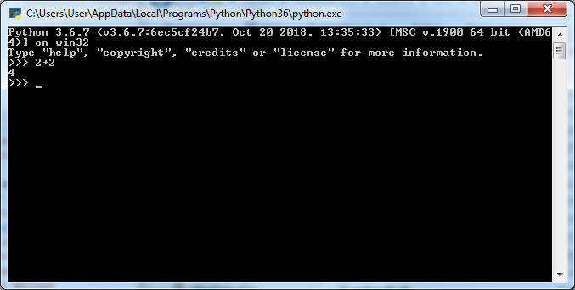
2.1. Python
C:\Users\User\AppData\Local\Programs\Python\Python36\Python.exe

Slide 13

2.2. PyCharm
Descargamos PyCharm Community de https://www.jetbrains.com/pycharm/download

Slide 14


2.2. PyCharm

Slide 15
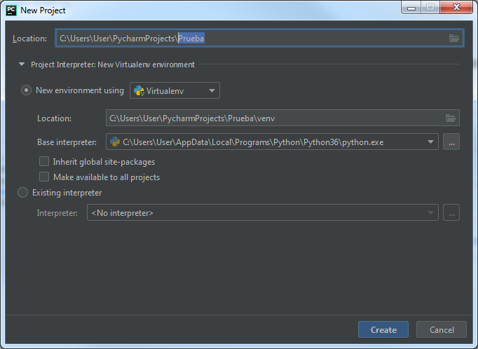
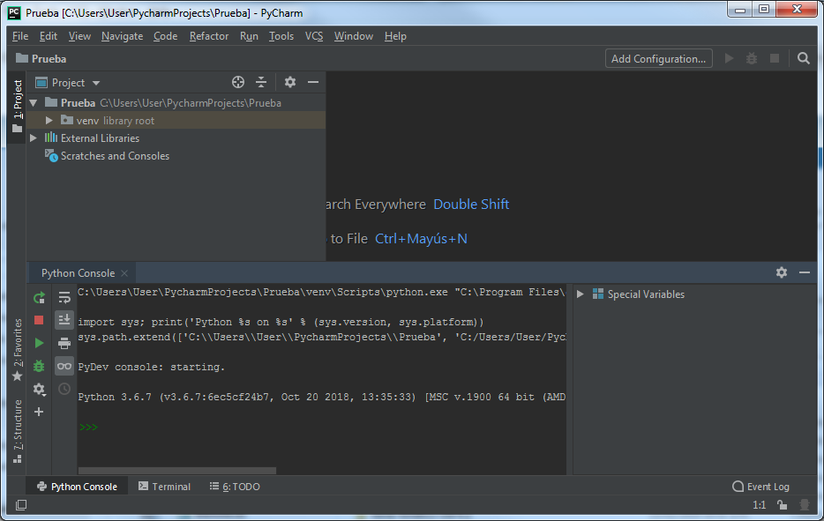
2.3. Crear Environments

Slide 16
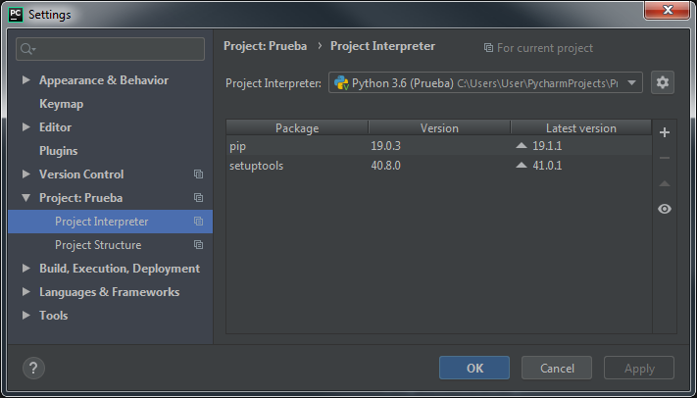
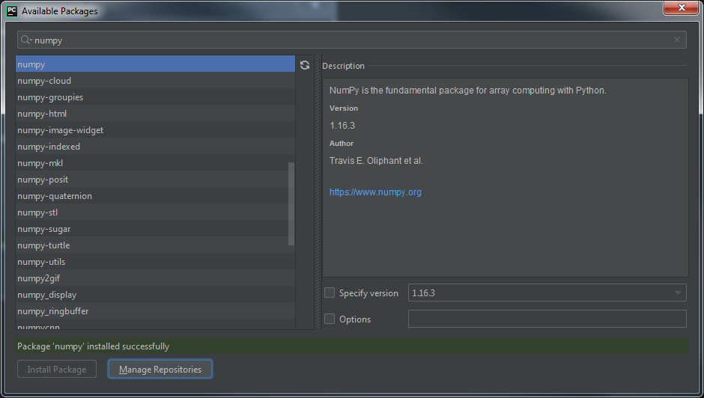
2.3. Instalación de Librerías
File -> Settings -> Project:Prueba -> Project Interpreter

Slide 17
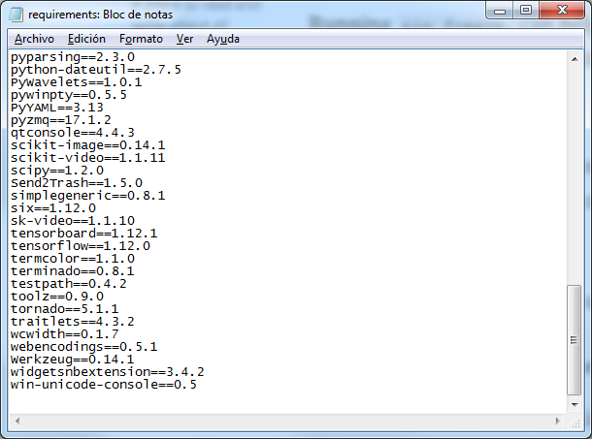
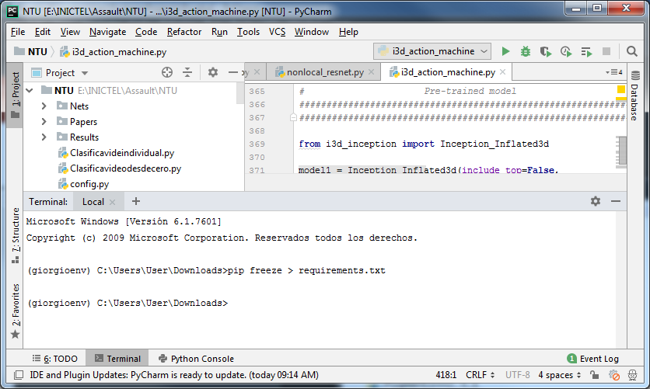
2.4. Intalación de Librerías
Tensorflow 1.12
Keras 2.2.4
OpenCV
Matplotlib
$pip freeze > requirements.txt.

Slide 18
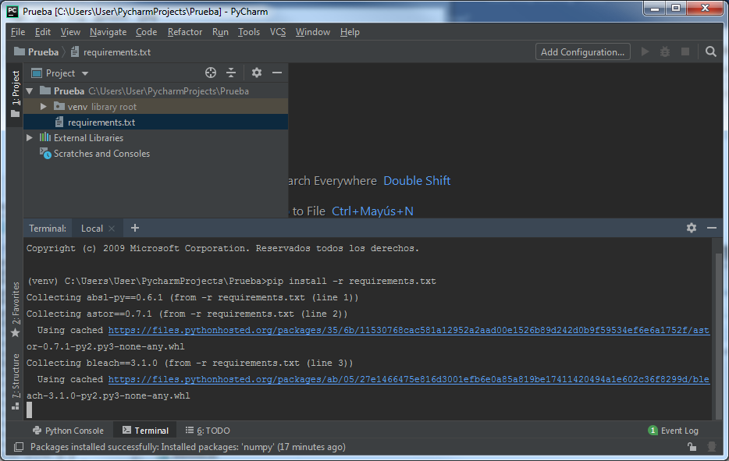
2.4. Intalación de Librerías
$ pip install -r requirements.txt

Slide 19
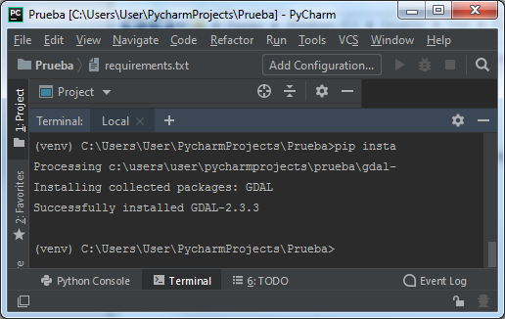
2.5. GDAL
Geospatial Data Abstraction Library o GDAL (también conocida como GDAL/OGR) es una biblioteca de software para la lectura y escritura de formatos de datos geoespaciales.
Para instalar GDAL:
Descargar “GDAL-2.3.3-cp36-cp36m-win_amd64.whl”
Copiar el archivo descargado al proyecto (o cambiar la ruta de la terminal a donde se haya descargado el archivo).
Escribir en al terminal “pip install GDAL-2.3.3-cp36-cp36m-win_amd64.whl”

Slide 20
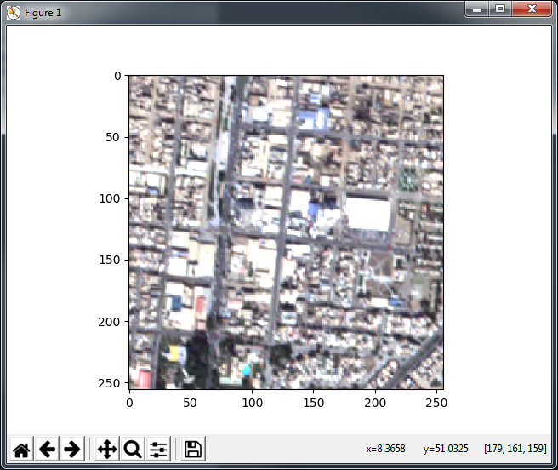
2.5. GDAL
import numpy as np import gdal import matplotlib.pyplot as plt ds = gdal.Open('PERUSATexample.tif') img = np.zeros((256, 256, 4),dtype=np.uint8) rb = ds.GetRasterBand(1) img_array = rb.ReadAsArray() img[:, :, 0] = img_array rb = ds.GetRasterBand(2) img_array = rb.RadAsArray() img[:, :, 1] = img_array rb = ds.GetRasterBand(3) img_array = rb.ReadAsArray() img[:, :, 2] = img_array rb = ds.GetRasterBand(4) img_array = rb.ReadAsArray() img[:, :, 3] = img_array plt.figure() plt.imshow(img[:,:,0:3]) plt.show()

Slide 21
2.6. Anaconda
Es una distribución de Python y R orientada a simplificar el despliegue y administración de los paquetes de software.
Para usar Anaconda:
Descargar “Python 3.7 version” de https://www.anaconda.com/distribution/#download-section
Abrir Anaconda Prompt.
Creamos un Environment con “conda create –n INICTEL python=3.6 pip”
Para instalar un paquete, buscarlo en “Anaconda Cloud” (https://anaconda.org/). Ejemplo:
GDAL: conda install -c conda-forge gdal==2.3.3
Numpy: conda install -c anaconda numpy
También se puede usar “pip”, e.g.: pip install Pillow
Ojo: conda install -c conda-forge tensorflow-gpu no siempre funciona (buscar .whl en https://pypi.org/)

Slide 22
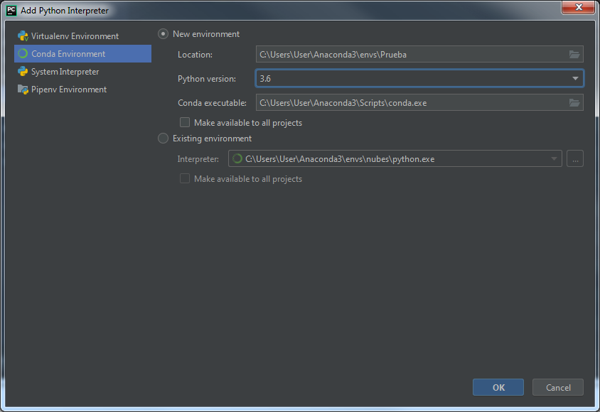
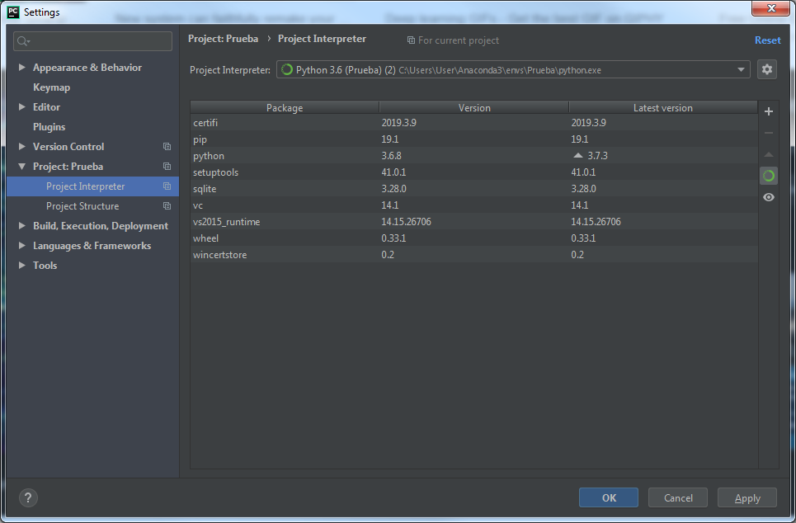
2.6. Anaconda en PyCharm
Es más práctico manejar environments de Anaconda en Pycharm.
File -> Settings -> Project:Prueba -> Project Interpreter -> -> Add -> Conda Environment

Slide 23
2.6. Tensorflow-gpu en Windows
GPU con soporte CUDA y Compute Capabilty>=3.1. Comprobar en: https://developer.nvidia.com/cuda-gpus
Descargar CUDA Toolkit 10.0: https://developer.nvidia.com/cuda-toolkit
Descargar cuDNN 7.5.1 para CUDA 10.0: https://developer.nvidia.com/rdp/cudnn-download
Copiar los archivos descargados de cuDNN a la carpeta de NVIDIA GPU Toolkit (‘C:\Program Files\NVIDIA GPU Computing Toolkit\CUDA\v10.0’)
Instalar “tensorflow-gpu 1.13.1”

Slide 24
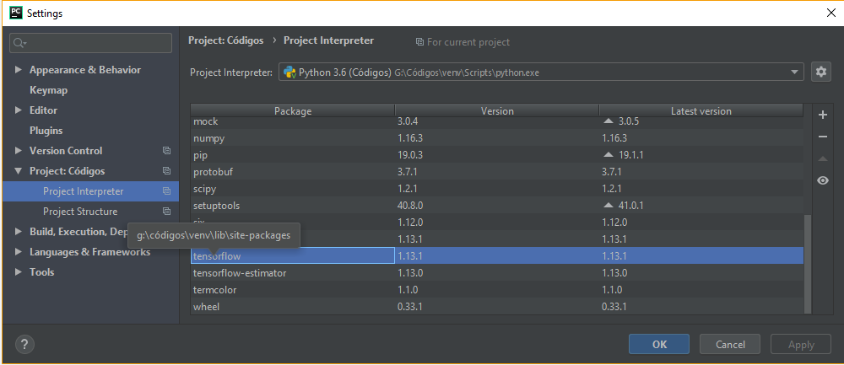
2.6. Tensorflow-gpu en Windows
SETTINGS TENSORFLOW (CPU)

Slide 25
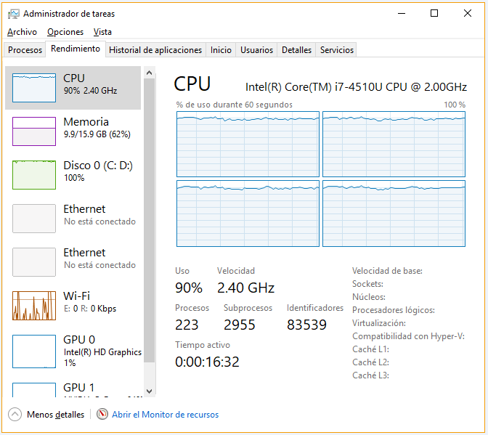
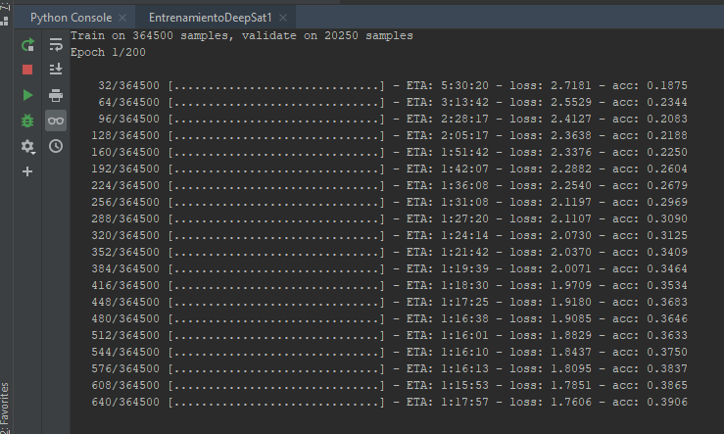
2.6. Tensorflow-gpu en Windows
Entrenamiento con Tensorflow CPU
Tiempo estimado por época: 1:15hr
Uso del CPU

Slide 26
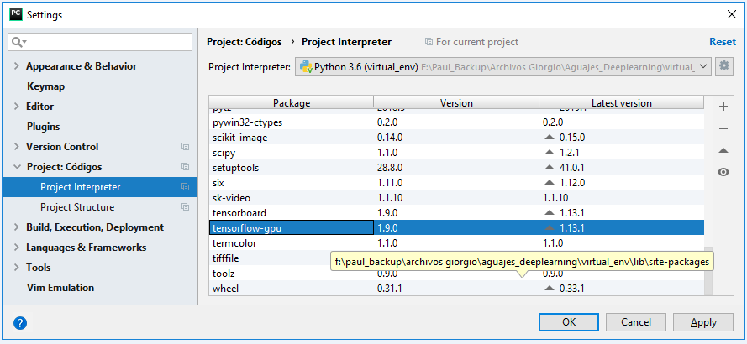
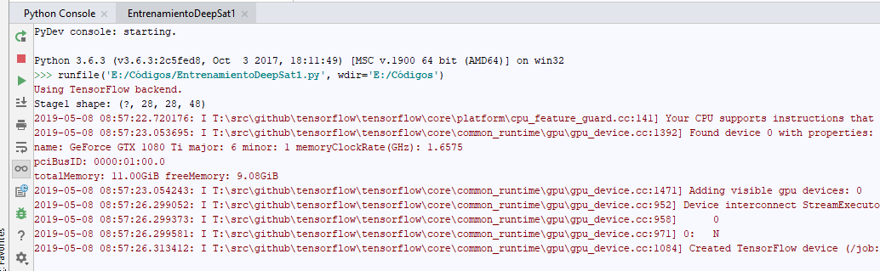
2.6. Tensorflow-gpu en Windows
SETTINGS TENSORFLOW-GPU

Slide 27
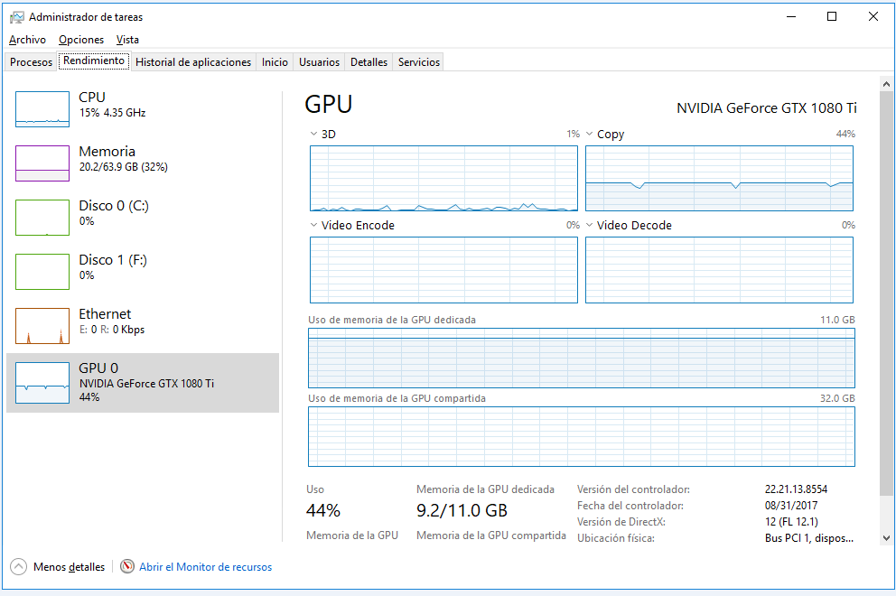
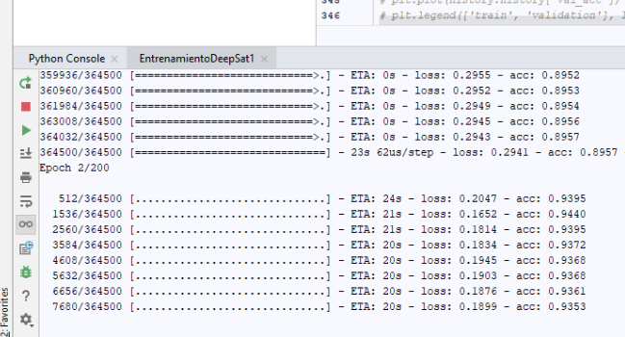
2.6. Tensorflow-gpu en Windows
Gpu usage, training time
23 segundos por época

Slide 28
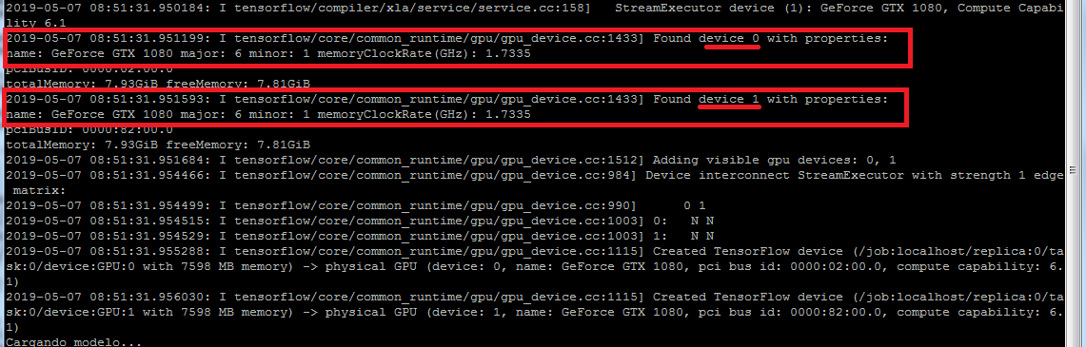
2.6. Tensorflow-gpu en Windows
Server INICTEL: 10.0.52.10. 2 GPUs GeForce GTX 1080.

Slide 29
3. CONVOLUTIONAL NEURAL NETWORKS

Slide 30
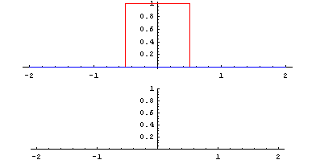

3.1. 2D Convolutions
En 1D:
$$\left(f∗g\right)\left(t\right)=\int_{−∞}^{+∞}{f\left(a\right)g\left(t−a\right)da}=\sum_{a=−∞}^{+∞}{f\left(a\right)g\left(t−a\right)}$$

Slide 31

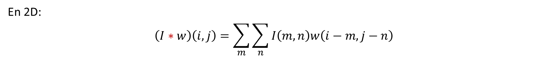

3.1. 2D Convolutions
En 2D:
$$\left(I∗w\right)\left(i,j\right)=\sum_{m}{\sum_{n}{I\left(m,n\right)w\left(i−m,j−n\right)}}$$
3 | 0 | 1 | 2 | 7 | 4
1 | 5 | 8 | 9 | 3 | 1
2 | 7 | 2 | 5 | 1 | 3
0 | 1 | 3 | 1 | 7 | 8
4 | 2 | 1 | 6 | 2 | 8
2 | 4 | 5 | 2 | 3 | 9
1 | 0 | -1
1 | 0 | -1
1 | 0 | -1
$$∗$$
$$=$$

Slide 32
3.1. 2D Convolutions
En 2D:
$$\left(I∗w\right)\left(i,j\right)=\sum_{m}{\sum_{n}{I\left(m,n\right)w\left(i−m,j−n\right)}}$$
3 | 0 | 1 | 2 | 7 | 4
1 | 5 | 8 | 9 | 3 | 1
2 | 7 | 2 | 5 | 1 | 3
0 | 1 | 3 | 1 | 7 | 8
4 | 2 | 1 | 6 | 2 | 8
2 | 4 | 5 | 2 | 3 | 9
3x1 + 0x0 + 1x-1 + 1x1 + 5x0 + 8x-1 +2x1 + 7x0 +2x-1 = -5
1 | 0 | -1
1 | 0 | -1
1 | 0 | -1
-5
1 | 0 | -1
1 | 0 | -1
1 | 0 | -1
$$∗$$
$$=$$

Slide 33
3.1. 2D Convolutions
En 2D:
$$\left(I∗w\right)\left(i,j\right)=\sum_{m}{\sum_{n}{I\left(m,n\right)w\left(i−m,j−n\right)}}$$
3 | 0 | 1 | 2 | 7 | 4
1 | 5 | 8 | 9 | 3 | 1
2 | 7 | 2 | 5 | 1 | 3
0 | 1 | 3 | 1 | 7 | 8
4 | 2 | 1 | 6 | 2 | 8
2 | 4 | 5 | 2 | 3 | 9
0x1 + 1x0 + 2x-1 + 5x1 + 8x0 + 9x-1 +7x1 + 2x0 +5x-1 = -4
1 | 0 | -1
1 | 0 | -1
1 | 0 | -1
-5
 | -4
 |  | 0 | 8
-10 | -2 | 2 | 3
0 | -2 | -4 | -7
-3 | -2 | -3 | -16
1 | 0 | -1
1 | 0 | -1
1 | 0 | -1
$$∗$$
$$=$$

Slide 34
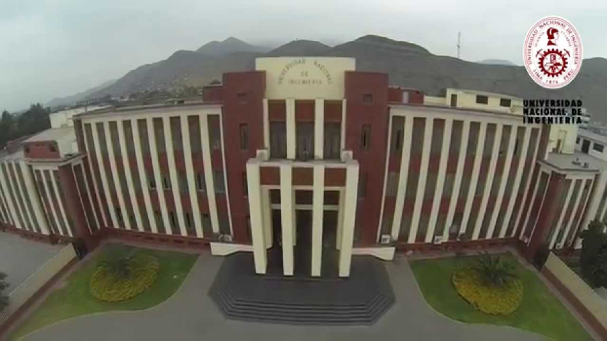
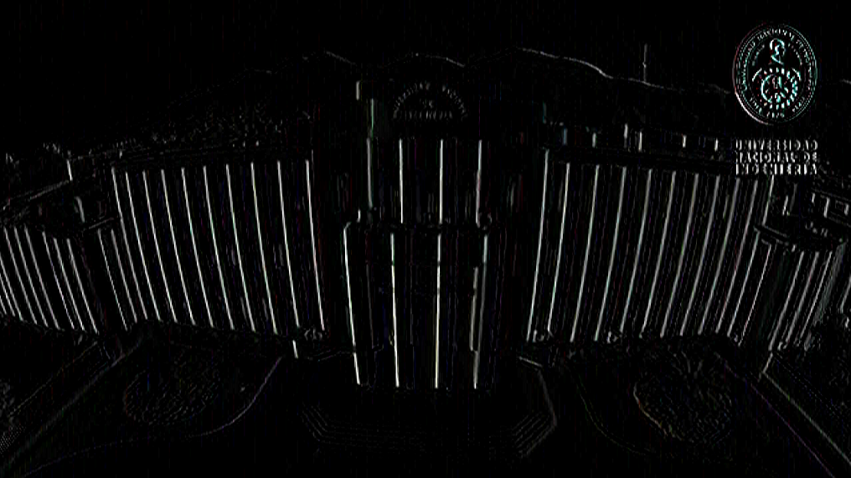
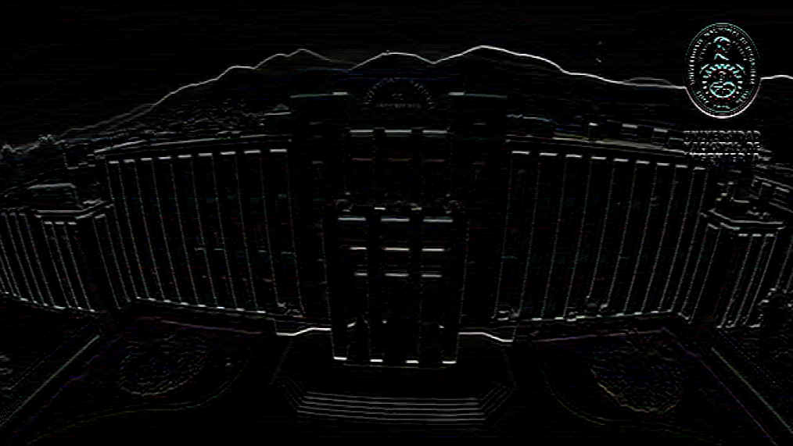
3.1. 2D Convolutions
Extracción de bordes verticales:
Extracción de bordes horizontales:
1 | 0 | -1
1 | 0 | -1
1 | 0 | -1
1 | 1 | 1
0 | 0 | 0
-1 | -1 | -1

Slide 35
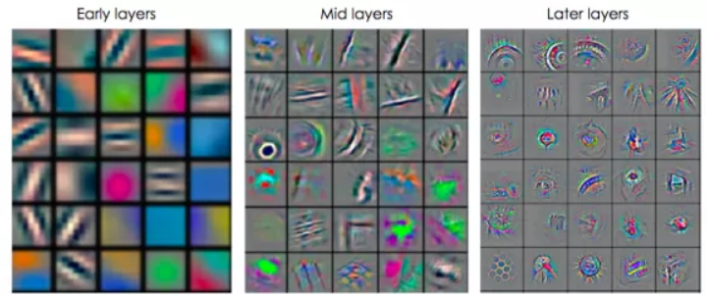
3.1. 2D Convolutions
El diseño específico de un filtro permite extraer características determinadas de una imagen (matriz)
w1 | w2 | w3
w4 | w5 | w6
w7 | w8 | w9
Weights (learnable parameteres)

Slide 36
3.1. 2D Convolutions
En Keras, una capa convolucional 2D se implementa con la función Conv2D. Documentación: https://keras.io/layers/convolutional/
Conv2D:
keras.layers.Conv2D(filters, kernel_size, strides=(1, 1), padding='valid', data_format=None, dilation_rate=(1, 1), activation=None)
Ejemplo:
from keras.layers.convolutional import UpSampling2D, Conv2D
...
x = Conv2D(64, kernel_size=3, strides=(2, 2), padding='same', use_bias=False, name='Conv')(d0)

Slide 37


3.1.1. Padding
$$∗$$
$$=$$
f x f
(N – f + 1) x (N – f + 1)
N x N
Las dimensiones se reducen rápidamente
Se desperdicia la información de los píxeles de los bordes

Slide 38
3.1.1. Padding
0 | 0 | 0 | 0 | 0 | 0 | 0 | 0
0 |  |  |  |  |  |  | 0
0 |  |  |  |  |  |  | 0
0 |  |  |  |  |  |  | 0
0 |  |  |  |  |  |  | 0
0 |  |  |  |  |  |  | 0
0 |  |  |  |  |  |  | 0
0 | 0 | 0 | 0 | 0 | 0 | 0 | 0
$$∗$$
$$=$$
3 x 3
4 x 4
6 x 6
8 x 8
6 x 6
En general: (N + 2p – f +1) x (N + 2p – f +1)
= (N x N)
Padding = p = 1
*cantidad de filas y columnas necesarias a agregar
para no alterar el tamaño en la salida
Entonces: p = (f – 1) / 2

Slide 39
3.1.1. Padding
“Valid”:
N x N * f x f -> (N – f + 1) x (N – f + 1)
x = Conv2D(64, kernel_size=3, strides=(2, 2), padding=‘valid', name='Conv')(d0)
“Same”:
Aplicamos un padding de p = (f-1) /2
N x N * f x f -> N x N
x = Conv2D(64, kernel_size=3, strides=(2, 2), padding='same', name='Conv')(d0)

Slide 40


3.1.2. Strided Convolution
2 | 3 | 7 | 4 | 6 | 2 | 9
6 | 6 | 9 | 8 | 7 | 4 | 3
3 | 4 | 8 | 3 | 8 | 9 | 7
7 | 8 | 3 | 6 | 6 | 3 | 4
4 | 2 | 1 | 8 | 3 | 4 | 6
3 | 2 | 4 | 1 | 9 | 8 | 3
0 | 1 | 3 | 9 | 2 | 1 | 4
2 | 3 | 7 | 4 | 6 | 2 | 9
6 | 6 | 9 | 8 | 7 | 4 | 3
3 | 4 | 8 | 3 | 8 | 9 | 7
7 | 8 | 3 | 6 | 6 | 3 | 4
4 | 2 | 1 | 8 | 3 | 4 | 6
3 | 2 | 4 | 1 | 9 | 8 | 3
0 | 1 | 3 | 9 | 2 | 1 | 4
3 | 4 | 4
1 | 0 | 2
-1 | 0 | 3
3 | 4 | 4
1 | 0 | 2
-1 | 0 | 3
91
$$∗$$
$$=$$
Stride = 2

Slide 41
3.1.2. Strided Convolution
2 | 3 | 7 | 4 | 6 | 2 | 9
6 | 6 | 9 | 8 | 7 | 4 | 3
3 | 4 | 8 | 3 | 8 | 9 | 7
7 | 8 | 3 | 6 | 6 | 3 | 4
4 | 2 | 1 | 8 | 3 | 4 | 6
3 | 2 | 4 | 1 | 9 | 8 | 3
0 | 1 | 3 | 9 | 2 | 1 | 4
2 | 3 | 7 | 4 | 6 | 2 | 9
6 | 6 | 9 | 8 | 7 | 4 | 3
3 | 4 | 8 | 3 | 8 | 9 | 7
7 | 8 | 3 | 6 | 6 | 3 | 4
4 | 2 | 1 | 8 | 3 | 4 | 6
3 | 2 | 4 | 1 | 9 | 8 | 3
0 | 1 | 3 | 9 | 2 | 1 | 4
3 | 4 | 4
1 | 0 | 2
-1 | 0 | 3
91
3 | 4 | 4
1 | 0 | 2
-1 | 0 | 3
 | 100
$$∗$$
$$=$$

Slide 42
3.1.2. Strided Convolution
2 | 3 | 7 | 4 | 6 | 2 | 9
6 | 6 | 9 | 8 | 7 | 4 | 3
3 | 4 | 8 | 3 | 8 | 9 | 7
7 | 8 | 3 | 6 | 6 | 3 | 4
4 | 2 | 1 | 8 | 3 | 4 | 6
3 | 2 | 4 | 1 | 9 | 8 | 3
0 | 1 | 3 | 9 | 2 | 1 | 4
2 | 3 | 7 | 4 | 6 | 2 | 9
6 | 6 | 9 | 8 | 7 | 4 | 3
3 | 4 | 8 | 3 | 8 | 9 | 7
7 | 8 | 3 | 6 | 6 | 3 | 4
4 | 2 | 1 | 8 | 3 | 4 | 6
3 | 2 | 4 | 1 | 9 | 8 | 3
0 | 1 | 3 | 9 | 2 | 1 | 4
3 | 4 | 4
1 | 0 | 2
-1 | 0 | 3
 |  | 83
3 | 4 | 4
1 | 0 | 2
-1 | 0 | 3
91 | 100
$$∗$$
$$=$$

Slide 43
3.1.2. Strided Convolution
2 | 3 | 7 | 4 | 6 | 2 | 9
6 | 6 | 9 | 8 | 7 | 4 | 3
3 | 4 | 8 | 3 | 8 | 9 | 7
7 | 8 | 3 | 6 | 6 | 3 | 4
4 | 2 | 1 | 8 | 3 | 4 | 6
3 | 2 | 4 | 1 | 9 | 8 | 3
0 | 1 | 3 | 9 | 2 | 1 | 4
2 | 3 | 7 | 4 | 6 | 2 | 9
6 | 6 | 9 | 8 | 7 | 4 | 3
3 | 4 | 8 | 3 | 8 | 9 | 7
7 | 8 | 3 | 6 | 6 | 3 | 4
4 | 2 | 1 | 8 | 3 | 4 | 6
3 | 2 | 4 | 1 | 9 | 8 | 3
0 | 1 | 3 | 9 | 2 | 1 | 4
91 | 100 | 83
3 | 4 | 4
1 | 0 | 2
-1 | 0 | 3
69
3 | 4 | 4
1 | 0 | 2
-1 | 0 | 3
$$∗$$
$$=$$

Slide 44
3.1.2. Strided Convolution
2 | 3 | 7 | 4 | 6 | 2 | 9
6 | 6 | 9 | 8 | 7 | 4 | 3
3 | 4 | 8 | 3 | 8 | 9 | 7
7 | 8 | 3 | 6 | 6 | 3 | 4
4 | 2 | 1 | 8 | 3 | 4 | 6
3 | 2 | 4 | 1 | 9 | 8 | 3
0 | 1 | 3 | 9 | 2 | 1 | 4
2 | 3 | 7 | 4 | 6 | 2 | 9
6 | 6 | 9 | 8 | 7 | 4 | 3
3 | 4 | 8 | 3 | 8 | 9 | 7
7 | 8 | 3 | 6 | 6 | 3 | 4
4 | 2 | 1 | 8 | 3 | 4 | 6
3 | 2 | 4 | 1 | 9 | 8 | 3
0 | 1 | 3 | 9 | 2 | 1 | 4
 | 91
3 | 4 | 4
1 | 0 | 2
-1 | 0 | 3
91 | 100 | 83
69
3 | 4 | 4
1 | 0 | 2
-1 | 0 | 3
$$∗$$
$$=$$

Slide 45
3.1.2. Strided Convolution
2 | 3 | 7 | 4 | 6 | 2 | 9
6 | 6 | 9 | 8 | 7 | 4 | 3
3 | 4 | 8 | 3 | 8 | 9 | 7
7 | 8 | 3 | 6 | 6 | 3 | 4
4 | 2 | 1 | 8 | 3 | 4 | 6
3 | 2 | 4 | 1 | 9 | 8 | 3
0 | 1 | 3 | 9 | 2 | 1 | 4
2 | 3 | 7 | 4 | 6 | 2 | 9
6 | 6 | 9 | 8 | 7 | 4 | 3
3 | 4 | 8 | 3 | 8 | 9 | 7
7 | 8 | 3 | 6 | 6 | 3 | 4
4 | 2 | 1 | 8 | 3 | 4 | 6
3 | 2 | 4 | 1 | 9 | 8 | 3
0 | 1 | 3 | 9 | 2 | 1 | 4
 |  | 127
3 | 4 | 4
1 | 0 | 2
-1 | 0 | 3
91 | 100 | 83
69 | 91
3 | 4 | 4
1 | 0 | 2
-1 | 0 | 3
$$∗$$
$$=$$

Slide 46
3.1.2. Strided Convolution
2 | 3 | 7 | 4 | 6 | 2 | 9
6 | 6 | 9 | 8 | 7 | 4 | 3
3 | 4 | 8 | 3 | 8 | 9 | 7
7 | 8 | 3 | 6 | 6 | 3 | 4
4 | 2 | 1 | 8 | 3 | 4 | 6
3 | 2 | 4 | 1 | 9 | 8 | 3
0 | 1 | 3 | 9 | 2 | 1 | 4
2 | 3 | 7 | 4 | 6 | 2 | 9
6 | 6 | 9 | 8 | 7 | 4 | 3
3 | 4 | 8 | 3 | 8 | 9 | 7
7 | 8 | 3 | 6 | 6 | 3 | 4
4 | 2 | 1 | 8 | 3 | 4 | 6
3 | 2 | 4 | 1 | 9 | 8 | 3
0 | 1 | 3 | 9 | 2 | 1 | 4
91 | 100 | 83
69 | 91 | 127
3 | 4 | 4
1 | 0 | 2
-1 | 0 | 3
44
$$∗$$
$$=$$
3 | 4 | 4
1 | 0 | 2
-1 | 0 | 3

Slide 47
3.1.2. Strided Convolution
2 | 3 | 7 | 4 | 6 | 2 | 9
6 | 6 | 9 | 8 | 7 | 4 | 3
3 | 4 | 8 | 3 | 8 | 9 | 7
7 | 8 | 3 | 6 | 6 | 3 | 4
4 | 2 | 1 | 8 | 3 | 4 | 6
3 | 2 | 4 | 1 | 9 | 8 | 3
0 | 1 | 3 | 9 | 2 | 1 | 4
2 | 3 | 7 | 4 | 6 | 2 | 9
6 | 6 | 9 | 8 | 7 | 4 | 3
3 | 4 | 8 | 3 | 8 | 9 | 7
7 | 8 | 3 | 6 | 6 | 3 | 4
4 | 2 | 1 | 8 | 3 | 4 | 6
3 | 2 | 4 | 1 | 9 | 8 | 3
0 | 1 | 3 | 9 | 2 | 1 | 4
91 | 100 | 83
69 | 91 | 127
44
3 | 4 | 4
1 | 0 | 2
-1 | 0 | 3
 | 72
$$∗$$
$$=$$
3 | 4 | 4
1 | 0 | 2
-1 | 0 | 3

Slide 48
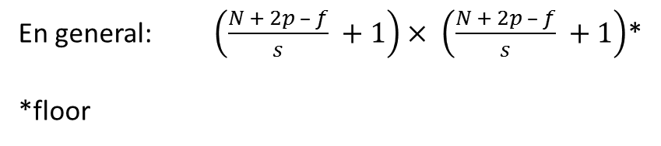
3.1.2. Strided Convolution
2 | 3 | 7 | 4 | 6 | 2 | 9
6 | 6 | 9 | 8 | 7 | 4 | 3
3 | 4 | 8 | 3 | 8 | 9 | 7
7 | 8 | 3 | 6 | 6 | 3 | 4
4 | 2 | 1 | 8 | 3 | 4 | 6
3 | 2 | 4 | 1 | 9 | 8 | 3
0 | 1 | 3 | 9 | 2 | 1 | 4
2 | 3 | 7 | 4 | 6 | 2 | 9
6 | 6 | 9 | 8 | 7 | 4 | 3
3 | 4 | 8 | 3 | 8 | 9 | 7
7 | 8 | 3 | 6 | 6 | 3 | 4
4 | 2 | 1 | 8 | 3 | 4 | 6
3 | 2 | 4 | 1 | 9 | 8 | 3
0 | 1 | 3 | 9 | 2 | 1 | 4
91 | 100 | 83
69 | 91 | 127
44 | 72
3 | 4 | 4
1 | 0 | 2
-1 | 0 | 3
 |  | 74
$$∗$$
$$=$$
3 | 4 | 4
1 | 0 | 2
-1 | 0 | 3
En general: $\left(\frac{N + 2p – f}{s} +1\right)× \left(\frac{N + 2p – f}{s} +1\right)$*
*floor

Slide 49
3.1.2. Strided Convolution
N x N * f x f -> $\left(\frac{N + 2p – f}{s} +1\right)× \left(\frac{N + 2p – f}{s} +1\right)$
x = Conv2D(64, kernel_size=3, strides=(2, 2), padding=‘valid', name='Conv')(d0)

Slide 50
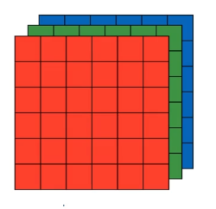
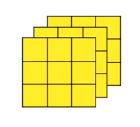
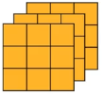




3.1.3. Convolutions over Volume
$$∗$$
$$=$$
3 x 3 x 3
$$=$$
4 x 4
6 x 6 x 3
$$=$$
4 x 4 x 2
3 x 3 x 3
4 x 4

Slide 51
3.1.3. Convolutions over Volume
x = Conv2D(64, kernel_size=3, strides=(2, 2), padding=‘valid', name='Conv')(d0)

Slide 52
3.1.4. Pooling
Max Pooling
1 | 3 | 2 | 1
2 | 9 | 1 | 1
1 | 3 | 2 | 3
5 | 6 | 1 | 2
9 | 2
6 | 3
Hyper-parámetros: f = 2, s = 2
X = MaxPooling2D(pool_size=(2, 2), strides=(2, 2), padding='valid')(X)

Slide 53
3.1.4. Pooling
Average Pooling
1 | 3 | 2 | 1
2 | 9 | 1 | 1
1 | 3 | 2 | 3
5 | 6 | 1 | 2
3.75 | 1.25
4 | 2
Hyper-parámetros: f = 2, s = 2
X = AveragePooling2D(pool_size=(2, 2), strides=(2, 2), padding='valid')(X)

Slide 54
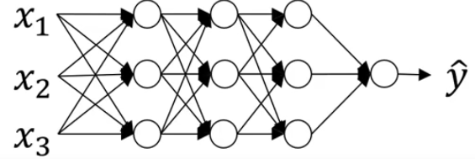





3.1.4. Batch-Normalization
Input normalization: $μ=\frac{1}{m}\sum_{i}{x^{(i)}}, x=x−μ$ $σ^{2}=\frac{1}{m}\sum_{i}{{x^{\left(i\right)}}^{2}}, x=x/σ^{2}$
Normalizar
Para los n datos intermedios de una capa: $z^{(1)},z^{(2)},…z^{(n)}$
$$μ=\frac{1}{m}\sum_{i}{z^{(i)}}$$
$$σ^{2}=\frac{1}{m}\sum_{i}{{{(z}^{\left(i\right)}−μ)}^{2}}$$
$$Z_{norm}^{\left(i\right)}=\frac{z^{\left(i\right)}−μ}{σ^{2}+ε}$$
$${\tilde{Z}}^{(i)} =γZ_{norm}^{\left(i\right)}+β$$
Learnable parameters
X = BatchNormalization(axis=3, name='bn_conv1')(X)

